Slide 1



OneReach x Oxford ChatGPT Study
Riddhi J. Pitliya and Santiago Castiello de Obeso
30 May 2024

Slide 2
Demographic Information
Total N | 100.00
Males | 60
Females | 39
Other Gender | 1
Mean Age | 38.51
SD Age | 8.12
Counterbalance A | 43
Counterbalance B | 56
GorillaExp A | 10
GorillaExp B | 34
GorillaExp AB | 55

Slide 3
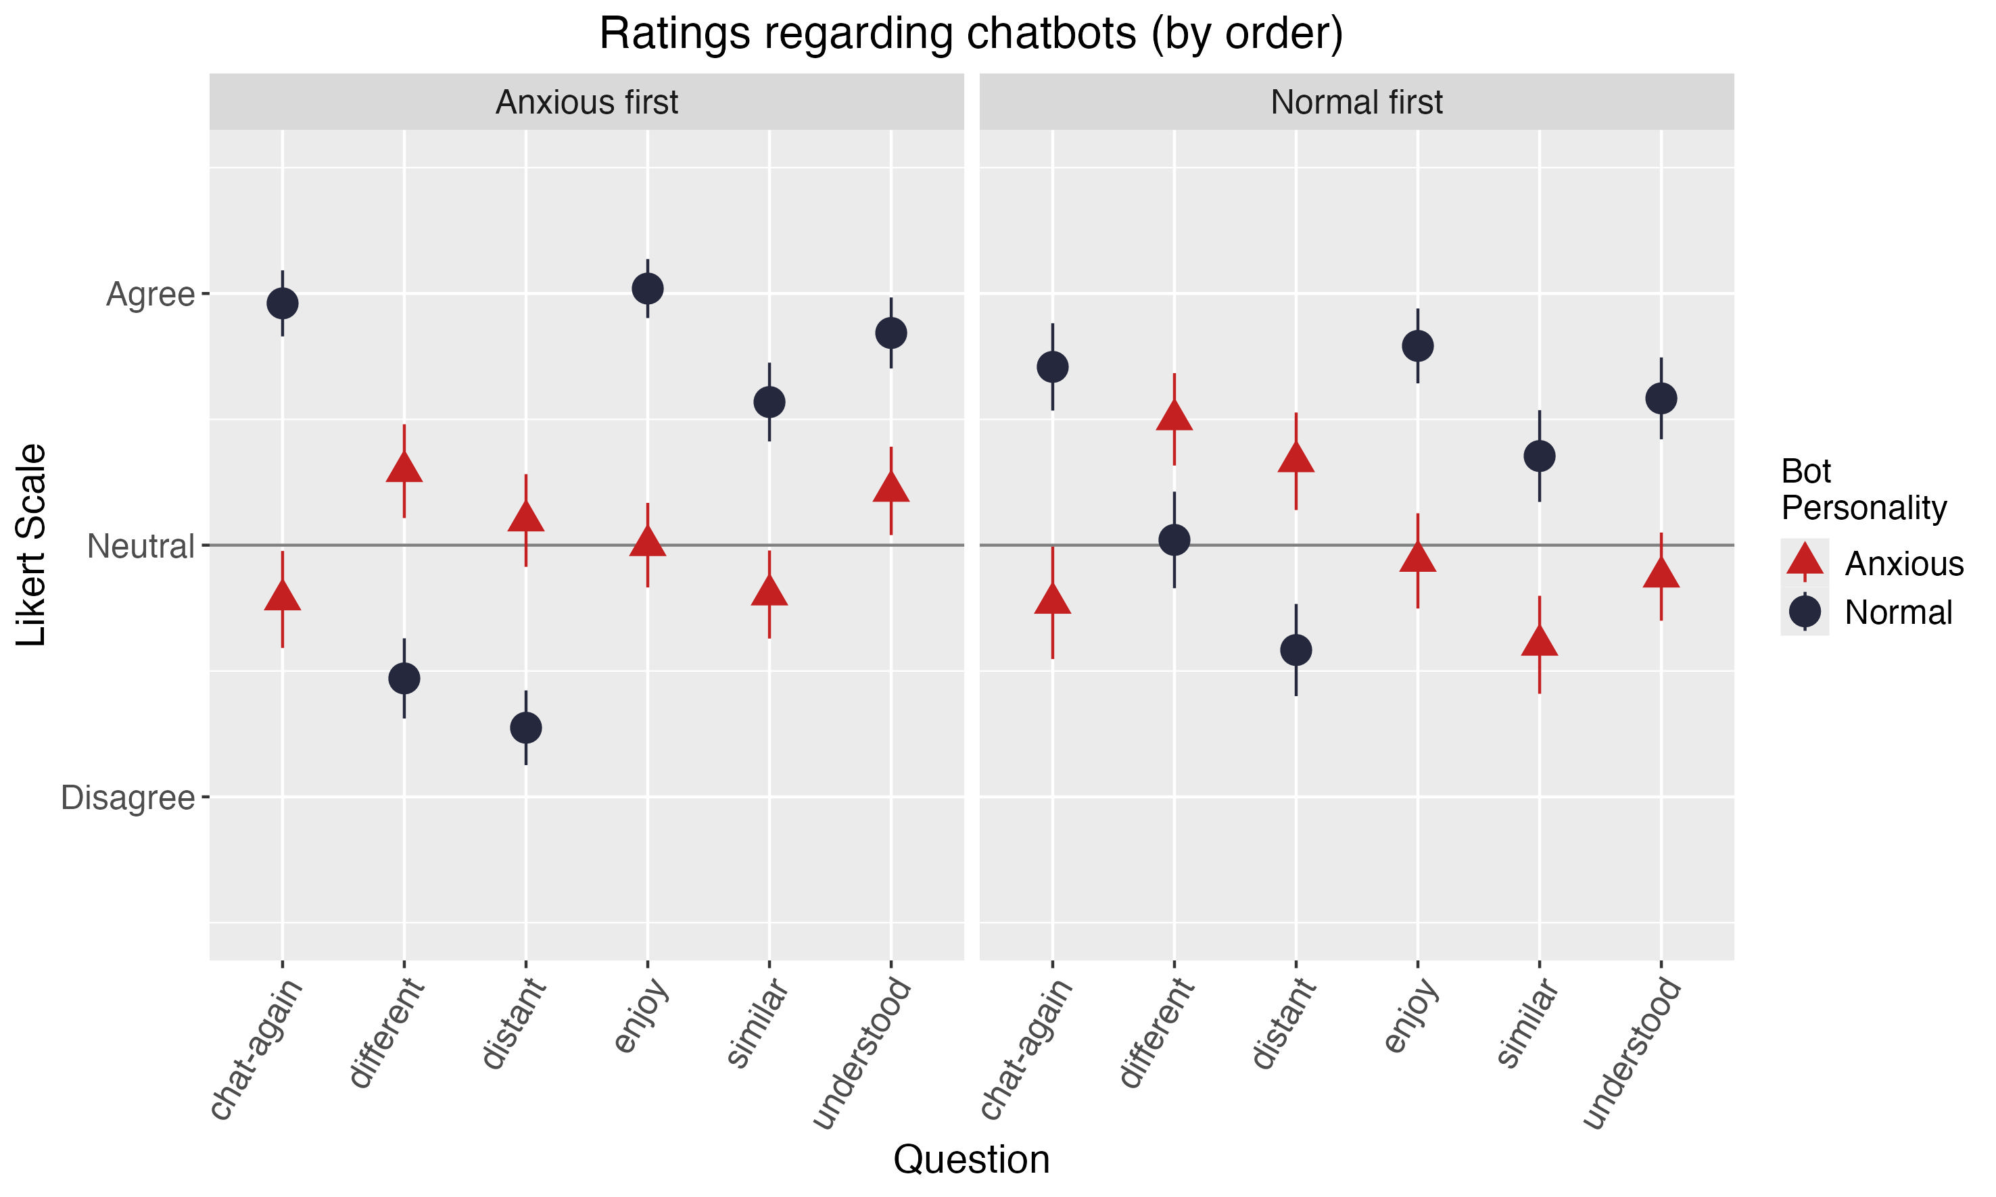
Upon visual inspection and statistical analysis, there is no effect of block order, so from here onwards, we visualise and analyse the results collapsed by block order.

Slide 4
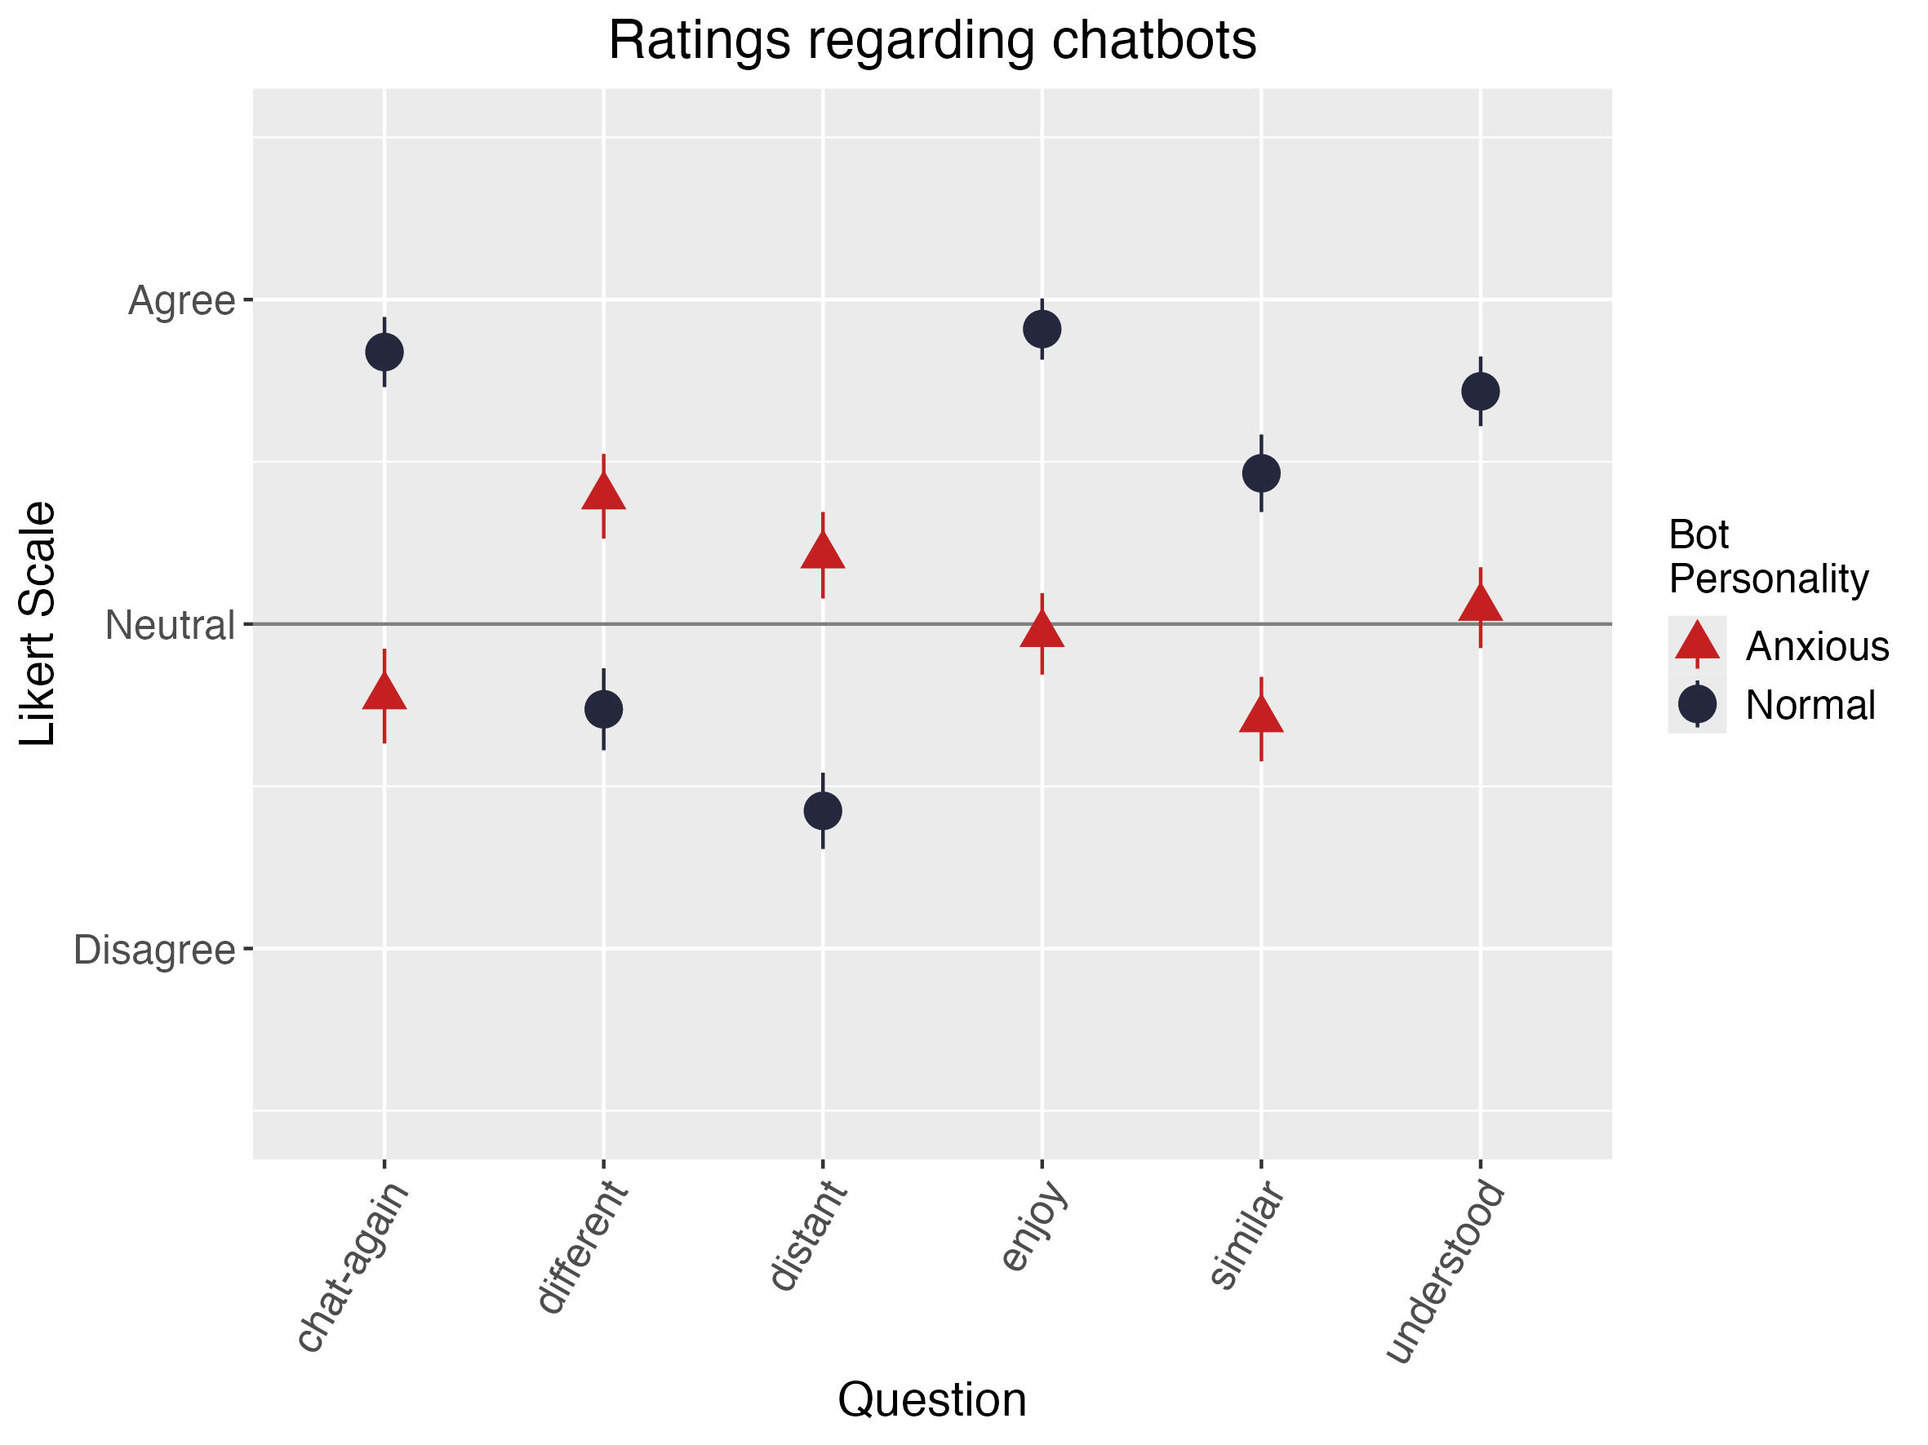
Note that the Response scales from Strongly Disagree to Strongly Agree.

Slide 5
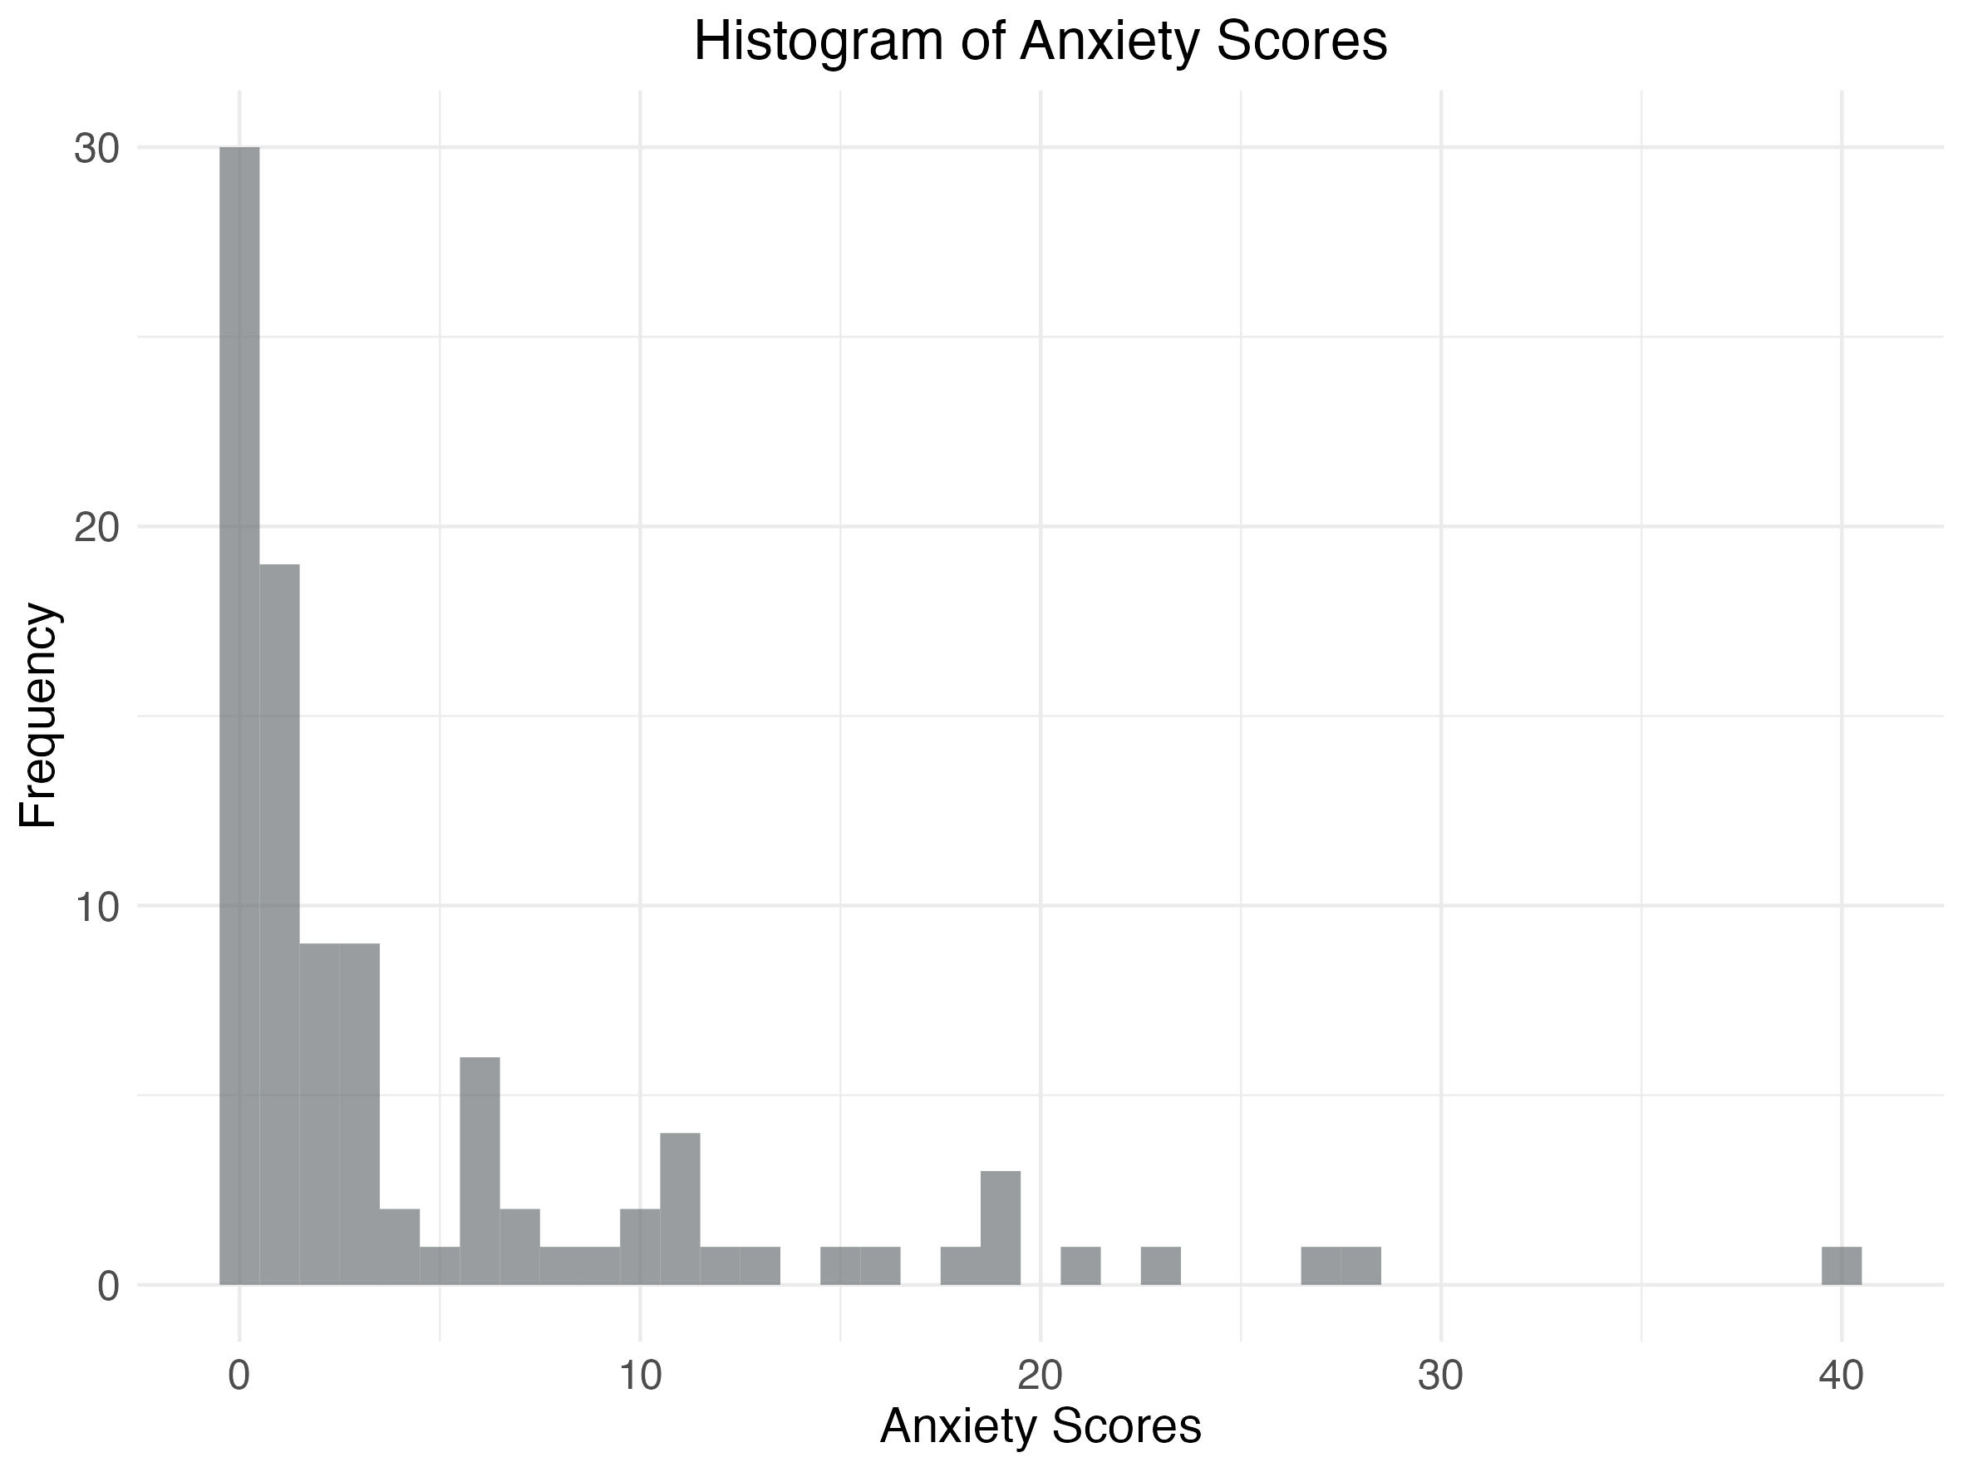
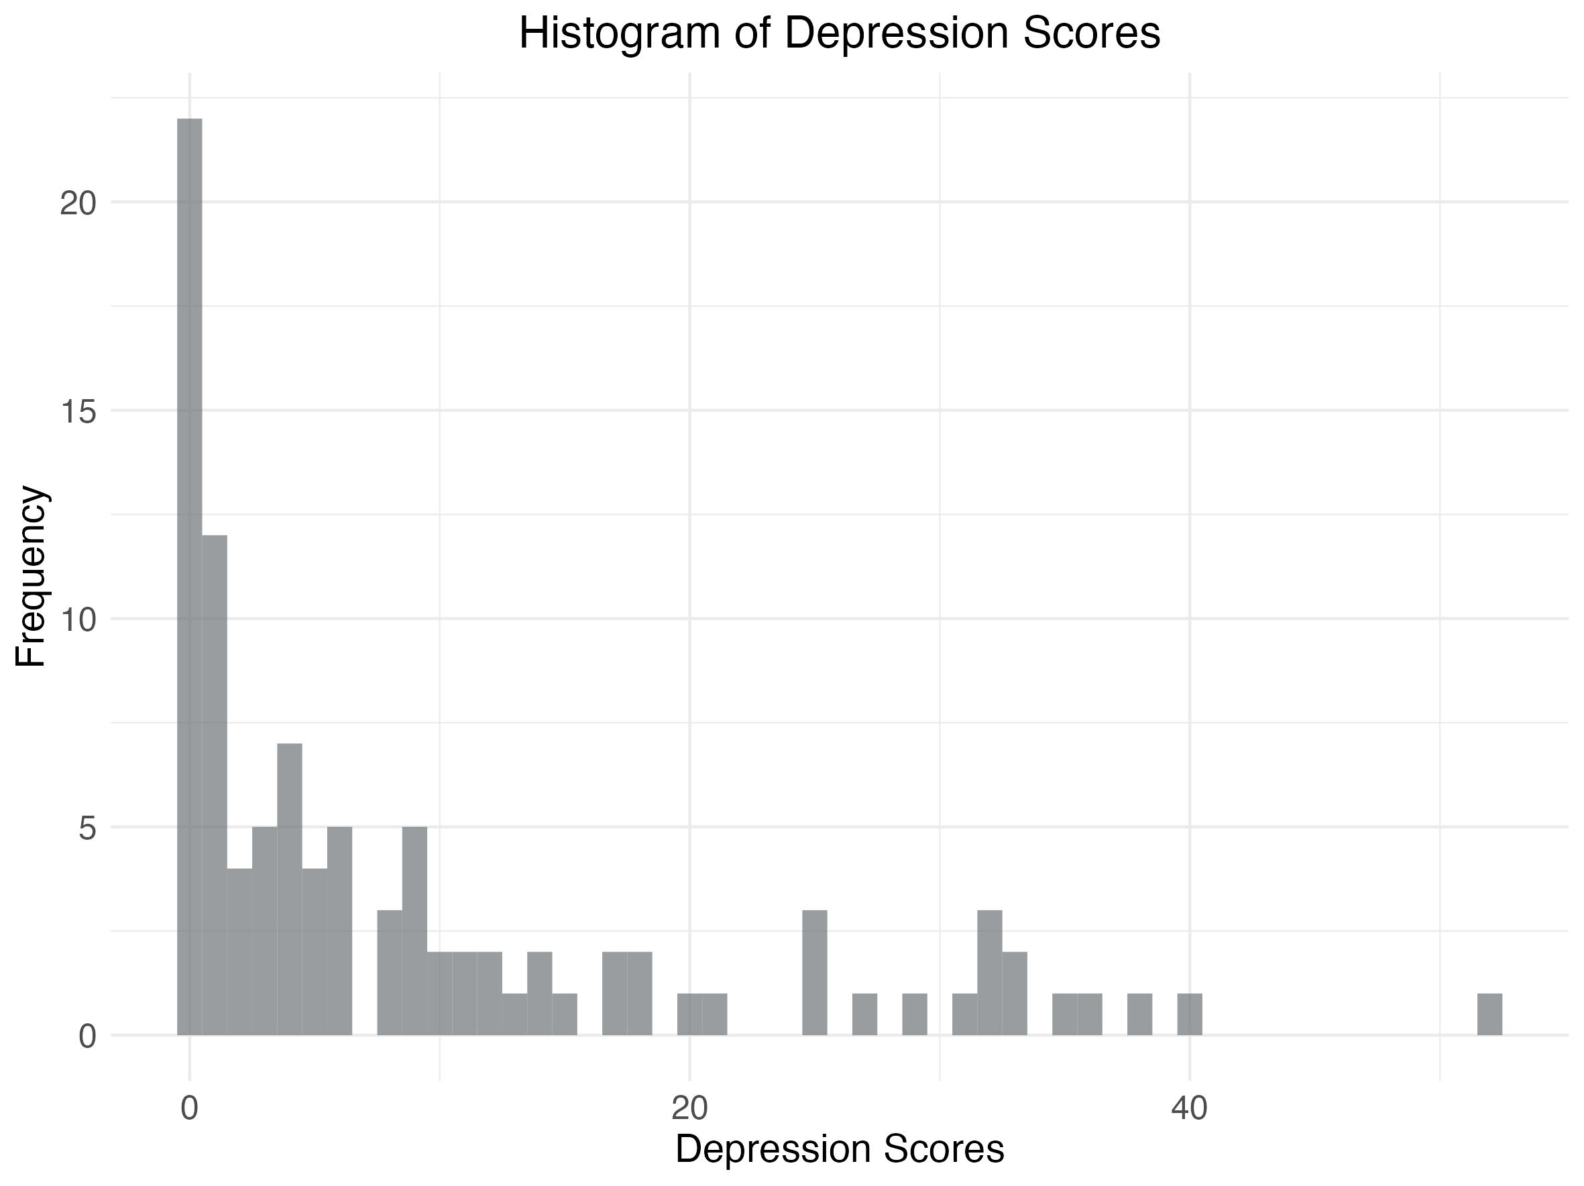
Distributions of Anxiety and Depression Scores

Slide 6
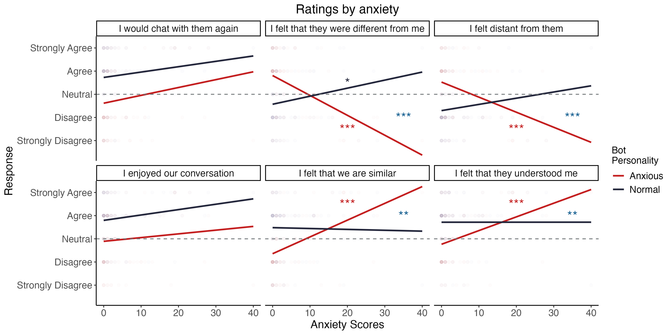
Blue stars indicate significant interaction effect. Red and blue stars indicate significant effect of the anxious and normal bot, respectively.

Slide 7
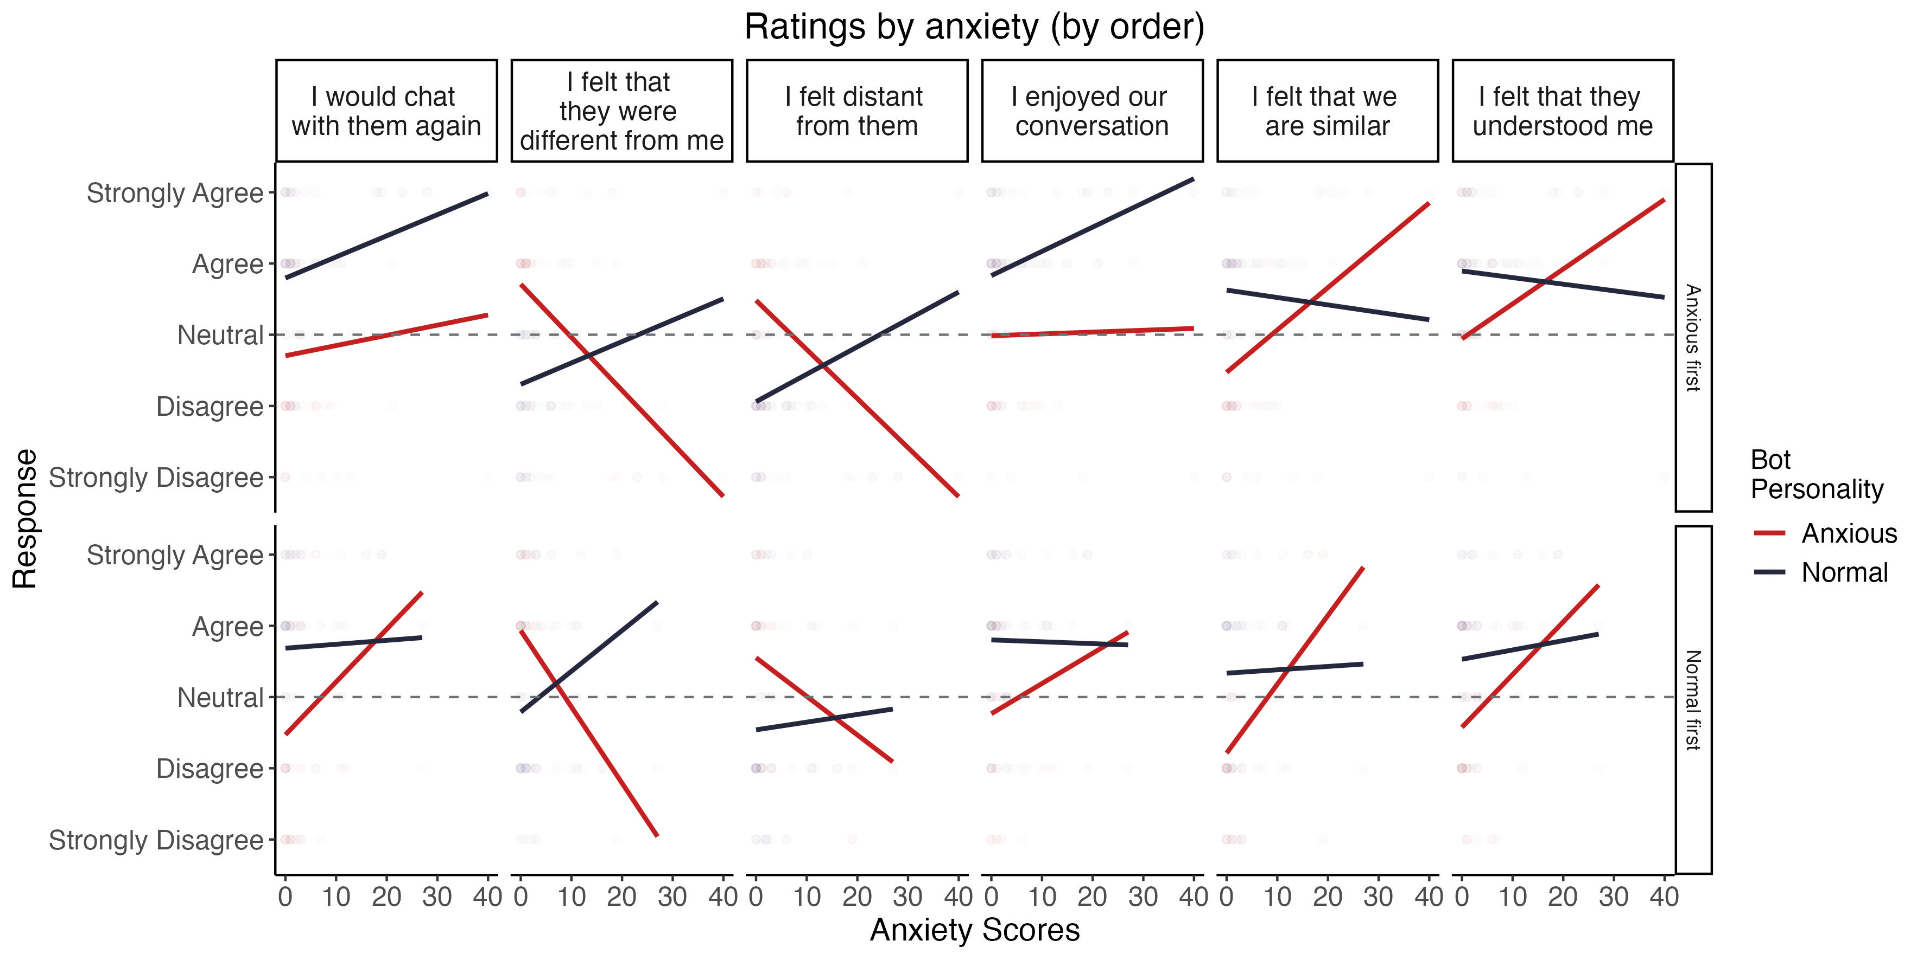
Wanted to see if there were any order effects here. Statistically, there are no order effects. Visually, there seems to be an effect in chat-again and enjoy.

Slide 8
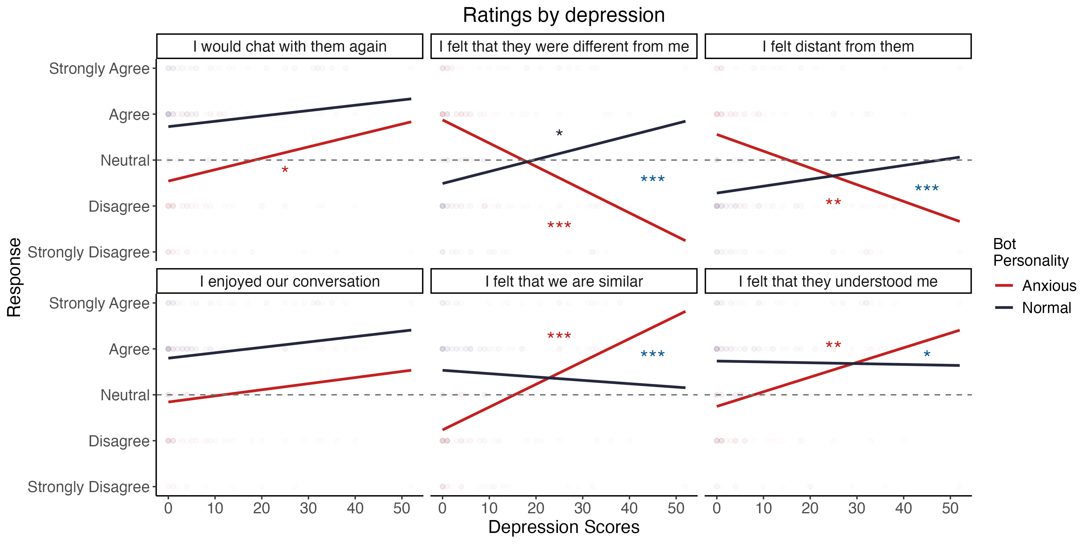
Blue stars indicate significant interaction effect. Red and blue stars indicate significant effect of the anxious and normal bot, respectively.

Slide 9
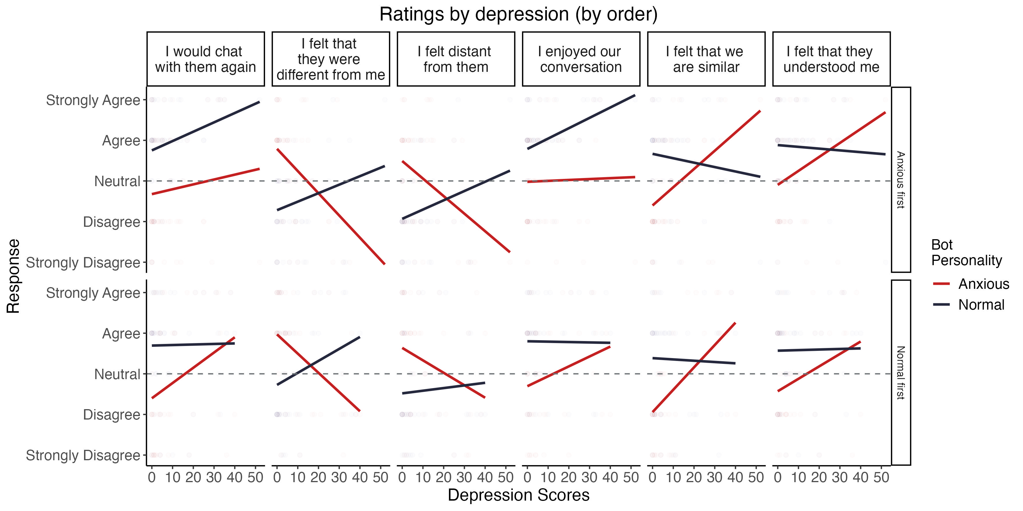
Wanted to see if there were any order effects here. Statistically, there are no order effects. Visually, there seems to be an effect in chat-again and enjoy.

